Slide 1
Chapter 6
Corporate-Level Strategy

Slide 2
The Role of Diversification
Diversification strategies play a major role in the behavior of large firms.
Product diversification concerns:
  the scope of the industries and markets in which the firm competes.
  how managers buy, create and sell different businesses to match skills and strengths with opportunities presented to the firm.

Slide 3
Two Strategy Levels
Business-level Strategy (Competitive)
  Each business unit in a diversified firm chooses a business-level strategy as its means of competing in its individual product markets.
Corporate-level Strategy (Companywide)
  Specifies actions taken by the firm to gain a competitive advantage by selecting and managing a group of different businesses competing in different product markets.

Slide 4
Corporate-Level Strategy:
Key Questions
Corporate-level Strategy’s Value
  The degree to which the businesses in the portfolio are worth more under the management of the firm than they would be under other ownership.
  What businesses should
  the firm be in?
  How should the corporate
  office manage the
  group of businesses?
Business Units

Slide 5
Levels of Diversification: Low Level
A
Dominant Business
  Between 70% and 95% of revenue
  comes from a singe business
Single Business
  95% or more revenue
  comes from a single business
A
B

Slide 6
Levels of Diversification: Moderate to High
Related Constrained
Related Linked (mixed related and unrelated
  Less than 70% of revenue comes from a single business and all businesses share product, technological and distribution linkages.
  Less than 70% of revenue comes from the dominant business, and there are only limited links between businesses.
A
A
B
C
B
C

Slide 7
Levels of Diversification:
Very High Levels
Unrelated Diversification
  Less than 70% of revenue comes from the dominant business, and there are no common links between businesses.
A
B
C

Slide 8
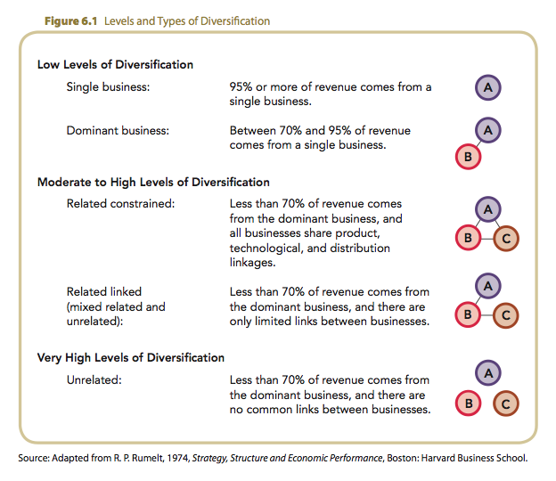
Levels of Diversification

Slide 9
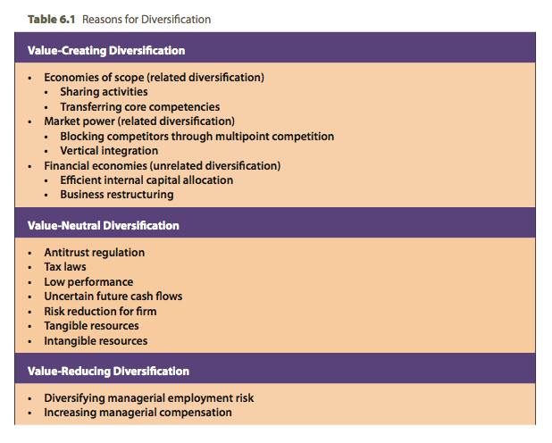
Reasons for Diversification

Slide 10
Value-Creating Strategies of Diversification
Operational and Corporate Relatedness
High
Related Constrained
Diversification
Vertical Integration
(Market Power)
Both Operational
and
Corporate Relatedness
Operational Relatedness: Sharing Activities between Businesses
Diversification
(Financial Economies)
(Rare capability that creates
diseconomies of scope)
Related Linked
Diversification
(Economies of Scope)
Low
High
Low
Corporate Relatedness: Transferring Skills into Businesses through Corporate Headquarters

Slide 11
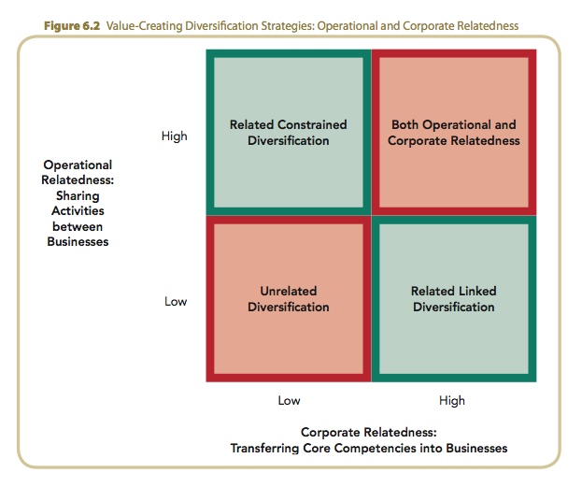
Value Creating Strategies: Operational and Corporate

Slide 12
Related Diversification
Firms create value by building upon or extending:
  resources
  capabilities
  core competencies
Economies of Scope
  Cost savings that occur when a firm transfers capabilities and competencies developed in one of its businesses to another of its businesses.

Slide 13
Related Diversification:
Economies of Scope
Value is created from economies of scope through:
  operational relatedness in sharing activities.
  corporate relatedness in transferring skills or corporate core competencies among units.
The difference between sharing activities and transferring competencies is based on how the resources are jointly used to create economies of scope.

Slide 14
Sharing Activities
Operational Relatedness
  Created by sharing either a primary activity such as inventory delivery systems, or a support activity such as purchasing.
  Activity sharing requires sharing strategic control over business units.
  Activity sharing may create risk because business-unit ties create links between outcomes.

Slide 15
Transferring Corporate Competencies
Corporate Relatedness
  Using complex sets of resources and capabilities to link different businesses through managerial and technological knowledge, experience, and expertise.

Slide 16
Corporate Relatedness
Creates value in two ways:
  eliminates resource duplication in the need to allocate resources for a second unit to develop a competence that already exists in another unit.
  provides intangible resources (resource intangibility) that are difficult for competitors to understand and imitate.
    A transferred intangible resource gives the unit receiving it an immediate competitive advantage over its rivals.

Slide 17
Related Diversification: Market Power
Market power exists when a firm can:
  sell its products above the existing competitive level and/or
  reduce the costs of its primary and support activities below the competitive level.

Slide 18
Related Diversification:
Market Power (cont’d)
Multipoint Competition
  Two or more diversified firms simultaneously compete in the same product areas or geographic markets.
Vertical Integration
  Backward integration — a firm produces its own inputs.
  Forward integration — a firm operates its own distribution system for delivering its outputs.

Slide 19
Related Diversification: Complexity
Simultaneous Operational Relatedness and Corporate Relatedness
  Involves managing two sources of knowledge simultaneously
    Operational forms of economies of scope
    Corporate forms of economies of scope
  Many such efforts often fail because of implementation difficulties.

Slide 20
Unrelated Diversification
Financial Economies:
  are cost savings realized through improved allocations of financial resources.
    Based on investments inside or outside the firm
  create value through two types of financial economies:
    Efficient internal capital allocations
    Purchase of other corporations and the restructuring their assets

Slide 21
Unrelated Diversification (cont’d)
Efficient Internal Capital Market Allocation
  Corporate office distributes capital to business divisions to create value for overall company.
    Corporate office gains access to information about those businesses’ actual and prospective performance.
  Conglomerate life cycles are fairly short life cycle because financial economies are more easily duplicated by competitors than are gains from operational and corporate relatedness.

Slide 22
Unrelated Diversification: Restructuring
Restructuring creates financial economies
  A firm creates value by buying and selling other firms’ assets in the external market.
Resource allocation decisions may become complex, so success often requires:
  focus on mature, low-technology businesses.
  focus on businesses not reliant on a client orientation.

Slide 23
External Incentives to Diversify
Anti-trust Legislation
Antitrust laws in 1960s and 1970s discouraged mergers that created increased market power (vertical or horizontal integration.
Mergers in the 1960s and 1970s thus tended to be unrelated.
Relaxation of antitrust enforcement results in more and larger horizontal mergers.
Early 2000: antitrust concerns seem to be emerging and mergers are now more closely scrutinized.

Slide 24
External Incentives to Diversify (cont’d)
Anti-trust Legislation
High tax rates on dividends cause
a corporate shift from dividends to buying and building companies in high-performance industries.
1986 Tax Reform Act
  Reduced individual ordinary income tax rate from 50 to 28 percent.
  Treated capital gains as ordinary income.
  Created incentive for shareholders to prefer dividends to acquisition investments.
Tax Laws

Slide 25
Internal Incentives to Diversify
Low Performance
High performance eliminates the need for greater diversification.
Low performance acts as incentive for diversification.
Firms plagued by poor performance often take higher risks (diversification is risky).

Slide 26
Internal Incentives to Diversify
Low Performance
Diversification may be defensive strategy if:
  product line matures.
  product line is threatened.
  firm is small and is in mature or maturing industry.
Uncertain Future Cash Flows

Slide 27
Internal Incentives to Diversify
Low Performance
Synergy exists when the value created by businesses working together exceeds the value created by them working independently.
But synergy creates joint interdependence between business units.
A firm may become risk averse and constrain its level of activity sharing.
A firm may reduce level of technological change by operating in more certain environments.
Uncertain Future Cash Flows
Synergy and Firm Risk Reduction

Slide 28
Resources and Diversification
A firm must have both:
  Incentives to diversify
  The resources required to create value through diversification—cash and tangible resources (e.g., plant and equipment)
Value creation is determined more by appropriate use of resources than by incentives to diversify.
Strategic competitiveness is improved when the level of diversification is appropriate for the level of available resources.

